Slide 1

Allie Project – IT Team up
Java Essential 2
2015
Joe Liu
Notes:
今天是Java Training的第二堂, 首先先問一下 大家對於上一堂課 有沒有甚麼問題?

Slide 2
Goal
Understand static and instance
Understand class load, initialization
Understand pass-by-value
Understand memory allocation and garbage collection
Understand class extend
Understand value binding
Understand java collection
Notes:
這一堂目標寫起來有點繁瑣,
念 念
希望大家認真快樂上課~

Slide 3
Design decision: to own or to share
To own
Non-static (instance) variables/methods (member) in an object belong to itself only. That is, instance member for each object will be stored in different location in memory.
Sometimes, you want to have member that are common to all objects in the same class. This is accomplished with the static modifier. Every instance of the class shares a static (class) member, which is in one fixed location in memory.
To share
Notes:
10m, 首先我們再來看一下前一堂課介紹過static
從class設計的角度看一下 一個要決定的問題: 獨有 跟 分享

Slide 4
The only exception in directly access rule
Instance methods can access instance member (variables and methods) directly.
Instance methods can access class member directly.
Class methods can access class member directly.
Class methods cannot access instance member directly—they must use an object reference. Also, class methods cannot use the this keyword as there is no instance for this to refer to.
Notes:
Static, non-static method對於 static/non-static variable, method的直接存取 一共有四條, 只有一條的結果跟別人相反 是不允許的
所以我們看一下這一條

Slide 5
Blue print: Directly Access test
package essential2.classVsInstance;
public class DirectlyAccessTester {
int instanceVariable = 0;
static int staticVariable = 0;
void testInstanceMethod() {
staticVariable = 1;
instanceVariable = 1;
this.instanceVariable = 2;
}
void testInstanceMethod2() {
testInstanceMethod();
}
static void testStaticMethod() {
staticVariable = 2;
//instanceVariable =1;
//this.instanceVariable =1;
//testInstanceMethod();
}
public static void main(String[] args) {
DirectlyAccessTester dat = new DirectlyAccessTester();
dat.testInstanceMethod2();
DirectlyAccessTester.testStaticMethod();
}
}
Directly Access的展示程式
靜態(類別)方法無法存取實例變數或方法, 無法使用this
Notes:
Static因為是shared於每個instance而不是被任何一個instance擁有所以無法直接使用instance member或是this
讓我們看一下Class初始化的步驟 會更有感覺

Slide 6
Rome wasn't built in a day
A class will be loaded the first time you create an object from the class or the first time you access a static field or method of the class. After loaded, the initialization will follow by below:
1
Initialize class variables/block
Once only when class is load
2
Every time when object is created
Initialize instance variables/block
3
Execute constructor
Notes:
10m, 羅馬不是一天造成, 你寫的Class也不是一個步驟就生出來在記憶體中了…
首先先看一下Class被載入到記憶體中的時機
接著 看一下載完的 依序初始化
所以可以發現雖然程式寫在同一個.java中 但是其實實際上生成時機是有差
Block區塊等下會用sample介紹

Slide 7

Blue print: The one - 1
package essential2. classVsInstance;
public class TheOne {
// 紀錄救世主的世代
static int generation = -1;
//紀錄每一代救世主的年齡
int age = -1;
// 靜態初始區塊(Static initialization block)
// 只會執行一次 (當藍圖被載入的時候)
static {
generation = 0;
}
// 物件初始區塊(Instance initialization block)
// 每次創立新物件時, 都會在建構子(constructor)執行前執行一次
{
age = 0;
generation = generation + 1;
}
//建構子, 創立物件進行初始化動作的方法
public TheOne() {
age = age + 1;
}
共享於此類別的每個物件
每個的物件自己持有一分
物件初始區塊一定會在建構子之前執行, 無關出現在程式中的位置
continue…
Notes:
一個 救世主的類別
有一個屬性是 generation 是共享每一個就救世主實體
另外有一個屬性是 age 是每一個救世主擁有的

Slide 8
Blue print: The one - 2
public static void main(String[] args) {
// 故事從這裡開始
// 人們相信將會有一個人起來領導他們對抗母體的殘害
// 他會是世人的救贖
TheOne neo = new TheOne();
neo.age = 70;
System.out.println("generation“ + generation + " Neo died at age " + neo.age);
// generation 1 Neo died at age 70
neo = null;
TheOne neoThe2nd = new TheOne();
neoThe2nd.age = 65;
System.out.println("generation“ + generation + " Neo died at age " + neoThe2nd.age);
// generation 2 Neo died at age 65
neoThe2nd = null;
TheOne neoThe3rd = new TheOne();
neoThe3rd.age = 85;
System.out.println("generation“ + generation + " Neo died at age " + neoThe3rd.age);
// generation 3 Neo died at age 85
neoThe3rd = null;
}
}
Notes:
所以對於static 跟 instance 還有 初始化的發生時間 應該有了了解

Slide 9
Assignment mystery
When you assign a value (primitive value or object) to a variable or pass a variable to a method, this action is called assignment.
Then, if we do some to variable, will it affect original variable?
Lion lion1 = new Lion("lion1");
Lion lion2 = new Lion("lion2");
ZooKeeper zk = new ZooKeeper();
//取出age, life log
int age = lion1.getAge();
StringBuilder sb = lion1.getLifeLog();
//試著修改age, web log
age = 10;
sb.append("sleep");
這些都是assignment, 就是將變數指向一個資料或是將變數傳給某一個方法
Notes:
接著我們看 變數的傳遞

Slide 10
What is passed?
When assign a value, Java only do pass-by-value. But it doesn’t mean all assignment is a copy. Look below picture
 | Stack |  | Heap
 | Lion lon1 | 0x1111
 | Lion lion2 | 0x2222
 | ZooKeeper zk | 0x3333
 | int age | 10
 | StringBuilder st | 0x444
 | Main
0x1111
int age: 1
StringBuilder lifeLog: 0x4444
0x4444
0x3333
0x2222
This is what Java pass, same way for every variable.
The difference is, for primitive type data, it’s a value copy;
for object type data, it’s memory location copy which means Java pass reference by value.
Notes:
10min

Slide 11
Who is who?
Lion lion1 = new Lion("lion1");
Lion lion2 = new Lion("lion2");
//將lion2指向lion1
lion2 = lion1;
//將lion1指向null
lion1 = null;
 | Stack |  | Heap
 | Lion lon1 | 0x1111 --> null
 | Lion lion2 | 0x2222 --> 0x1111
 | Main
1
2
0x1111
String name: lion1
0x2222
String name: lion2
Now , lion2 is the lion object with name lion1;
Notes:
這裡做一個考題…
Assignment有沒有問題

Slide 12
Java memory - 1
Heap :
used by JVM to allocate memory to objects and classes. Global variable (class & instance) stored in heap. Classes are stored in a special heap space called Permanent Generation (PermGen).
Garbage Collection runs on the heap memory to free the memory used by objects that doesn’t have any reference.
Notes:
20m 接著講一下Java memory的配置

Slide 13
Garbage Collection? not in control!!
Garbage collection (GC) automatically runs in backend. The condition for an object to garbage candidate is it isn’t referenced by any other object. But the time JVM to free the memory and what object will be freed is ruled by JVM Algorithm. Even you can force a GC, but you can’t guarantee what will be freed.
In most case, we only need to mark the candidate for JVM to keep more effective memory usage through runtime.

Slide 14
Make it candidate
Lion lion1 = new Lion("lion1");
Lion lion2 = new Lion("lion2");
//將lion2指向lion1
lion2 = lion1;
//將lion1指給null
lion1 = null;
lion2 = null;
System.gc();
GC candidate
 | Stack |  | Heap
 | Lion lon1 | 0x1111 --> null
 | Lion lion2 | 0x2222 --> 0x1111
 | Main
0x1111
0x2222
等待主(JVM)的招喚…
等待主(JVM)的招喚…
 | Stack |  | Heap
 | Lion lon1 | null
 | Lion lion2 | 0x1111 --> null
 | Main
0x1111
0x2222

Slide 15
Java memory - 2
Stack:
used for used for execution of a thread. Those variable declared in method stored in Stack, It could be a primitive value or a location that reference to other objects in the heap.
Stack memory size is very less and very fast compared to Heap memory.
Design in LIFO (Last-In-First-Out) order. Whenever a method is invoked, a new block is created in the stack memory for the method to hold local variable. As soon as method ends, the block becomes unused and become available for next method.

Slide 16
LIFO - 1
Demo Stack LIFO feature by below class: King
public class King {
public static void main(String[] args) {
Foo foo = new Foo();
foo.tellBarDoSomething();
}
}
1
Foo foo = new Foo();
 | Stack |  | Heap
 | Foo foo | 0x1111
 | Main
0x1111 foo

Slide 17
LIFO - 2
2
foo.tellBarDoSomething();
public class Foo {
void tellBarDoSomething() {
Bar bar = new Bar();
bar.doSomething();
}
}
3
Bar bar = new Bar();
Stack |  | Heap
Foo foo | 0x1111
Main
Bar bar | 0x2222
foo tellBarDoSomething
0x1111 foo
0x2222 bar

Slide 18
LIFO - 3
4
public class Bar {
void doSomething() {
int i = 0;
i = i + 1;
}
}
bar.doSomething();
5
int i = 0;
Stack |  | Heap
Foo foo | 0x1111
Main
Bar bar | 0x2222
foo.tellBarDoSomething
int i | 0
bar.doSomething
0x1111 foo
0x2222 bar

Slide 19
LIFO - 4
6
i = i + 1;
Stack |  | Heap
Foo foo | 0x1111
Main
Bar bar | 0x2222
foo.tellBarDoSomething
int i | 1
bar.doSomething
0x1111 foo
0x2222 bar
7
End of bar.doSomething, free related memory
Stack |  | Heap
Foo foo | 0x1111
Main
Bar bar | 0x2222
foo.tellBarDoSomething
0x1111 foo
0x2222 bar

Slide 20
LIFO - 5
8
End of foo.tellBarDoSomething, free related memory
GC candidate
Stack |  | Heap
Foo foo | 0x1111
Main
0x1111 foo
0x2222 bar
9
End of main, free related memory
Stack |  | Heap
0x1111 foo
0x2222 bar

Slide 21
LIFO - 6
As demo, we can see LIFO meets the progress of method execution. The last call will return to the previous call and so on.
The data in stack will follow LIFO to release the memory, so we didn’t need to handle it.

Slide 22
When there is no room …
When stack memory is full, Java runtime (JVM) throws java.lang.StackOverFlowError whereas if heap memory is full, it throws java.lang.OutOfMemoryError: Java Heap Space error.
We can use -Xms and -Xmx JVM option to define the startup size and maximum size of heap memory. We can use -Xss to define the stack memory size.
Ex: java -Xmx2048m -Xms256m someClass
http://docs.oracle.com/javase/8/docs/technotes/tools/windows/java.html

Slide 23

A universe for the class load, object live and die
The JVM

Slide 24
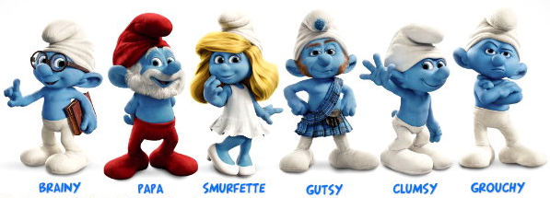
Let’s look at the relation between classes
Notes:
20m

Slide 25

The eldest grandpa
In Java, there is a class that all other classes are extended from it. This class is java.lang.Object, stands in the top place of Java class hierarchy tree. The package java.lang. is the default imported package in every Java class.

Slide 26
Like father like son
What will be if a class extend from a class? The sub-class will have all asset (class & instance member) from super-class.
public class GrandPapa {
static String familyInstructions = "Love the world";
String name = "John";
void makeLiving() {
System.out.println("do finishing");
}
}
public class Papa extends GrandPapa {
public static void main(String[] args) {
System.out.println(familyInstructions);
Papa papa = new Papa();
System.out.println(papa.name);
papa.makeLiving();
}
}
extends是java中Class繼承的關鍵字, 只能繼承一個Class, Java不支援多重繼承
Java另外有一個東西叫做介面(interface), 一種類似空殼的物件, 可以讓物件多重實作這些介面, 介面以及抽象類別之後再介紹

Slide 27
A new generation, a new way
You can overwrite the asset (variable & method). The best thing is the change in child class won’t affect the parent’s class.
public class Son extends Papa {
String name = "Paul";
void makeLiving() {
System.out.println("do hunting");
}
public static void main(String[] args) {
System.out.println(familyInstructions);
Son son = new Son();
System.out.println(son.name);
son.makeLiving();
}
}

Slide 28



This is a dog?
Let’s say we have a class: Dog, and it’s sub-class: Husky, Chihuahua …
We can do this in Java.
We can’t do this in Java.
A Husky, Chihuahua must be a Dog;
But a Dog might not be a Husky, Chihuahua.
Dog laiFu = new Husky();
Dog laiOne = new Chihuahua();
Husky laiFu2 = new Dog();
Chihuahua laiOne2 = new Dog();
狗

Slide 29
See is one, act as another …
Dog laiFu = new Husky();
Dog laiOne = new Chihuahua();
laiFu.bark();
laiOne.bark();
laiFu.bite();
laiOne.makeCute();
等號左邊是Java視為的物件類型, 右邊是實際上被操作的物件, 有哪些屬性跟方法是由視為的物件決定, 而實際的表現行為是看右邊的物件
public class Dog {
void bark() {
System.out.print("woof woof");
}
}
public class Chihuahua extends Dog {
void bark() {
System.out.print("wow wow");
}
void makeCute() {
System.out.print("be cute");
}
}
public class Husky extends Dog {
void bark() {
System.out.print("bow bow");
}
void bite() {
System.out.print("bite");
}
}

Slide 30

It’s all about size
Let’s do the same test in primitive value.
We can do this in Java.
We can’t do this in Java.
Large box can contain small one;
But small box can’t contain large one.
int長度是32bit, double長度是64bit
int i = 3;
double j = i;
double i2 = 3;
int j2 = i2;

Slide 31
Data equivalent
In primitive value, we can use operator: == to compare value of one variable to another.
In object, we can also use operator: ==, it compares two object’s memory location. In Object (java.lang.Object), there is a method: equals, in default this methods do the same thing as ==. But you can overwrite this method to meet the comparison requirement

Slide 32
Array
Array is an object (java.util.Arrays), it is a container with fixed length and with an order to set or get data.
public class ArrayTester {
public static void main(String[] args) {
//一定要先指定陣列長度, 指定完後無法更改
Object[] oArray = new Object[5];
int[] iArray = new int[5];
int[][] iArrayArray = new int[5][];
int[][] iArrayArray2 = {{1,2,3},{1},{1,2}};
System.out.println(oArray.length);
System.out.println(iArrayArray2[0].length);
oArray[0] = new Object();
oArray[1] = new Object();
}
}
Notes:
10m

Slide 33
Collection - 1
java.util.Collection are top interface of Java collection class hierarchy tree
When a collection with ordered, it means order of data is by the order: insert time, position
When a collection with sorted, it means the order of data is by a special rule of property of data, ex: a container decide the order by object’s property: name or age.
A container can be “with ordered without sorted”, but can’t be “without ordered with sorted”.

Slide 34
Collection - 2
Main 3 java collection type. Under this 3 type, there are many collection classes for you to use.
List | Set | Map
contain a list of thing | contain unique things | contain things with unique ID

Slide 35
Which Java collection to use?
Ordering: Need or not need some sort of ordering in the elements.
Duplicates: May or may not want to allow duplicate elements in a collection.
Thread safe: Ensure the safety of the elements in a collections in case there are multiple threads accessing it.
Key-Value pair: Store in key-value pairs.
Random Access: Instant retrieval of an element.
Use Case: what’s most use case of this collection in your code. Mass retrieval or insert and delete?
http://www.janeve.me/articles/which-java-collection-to-use

Slide 36
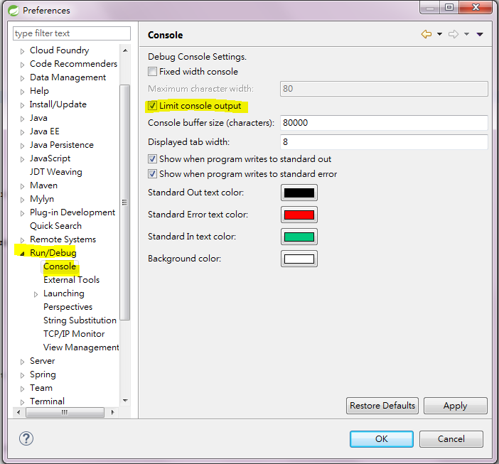
IDE console
Eclipse base IDE, ex: STS, console has max output limitation, so you sometimes might only see part of logs
In Windows -> Preferences -> Run/Dubug -> Console, it can adjust console max output size to large or unlimited

Slide 37
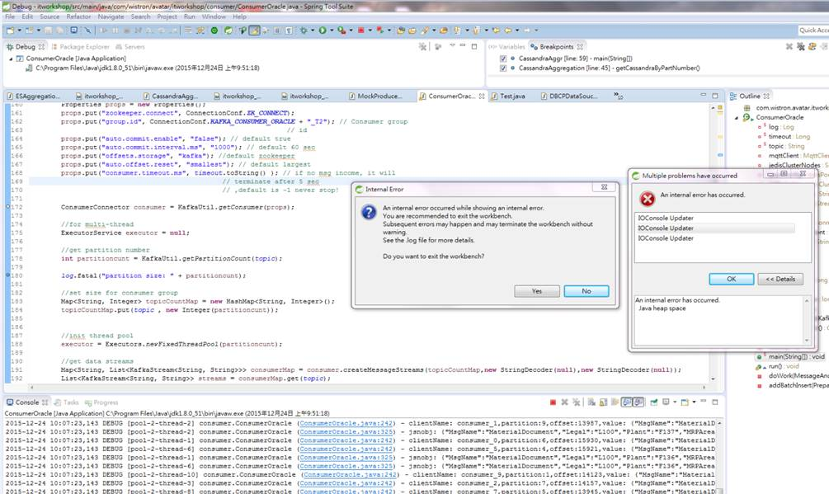
When the console is out of memory, it will show above error

Slide 38


Thank You !

